Slide 1
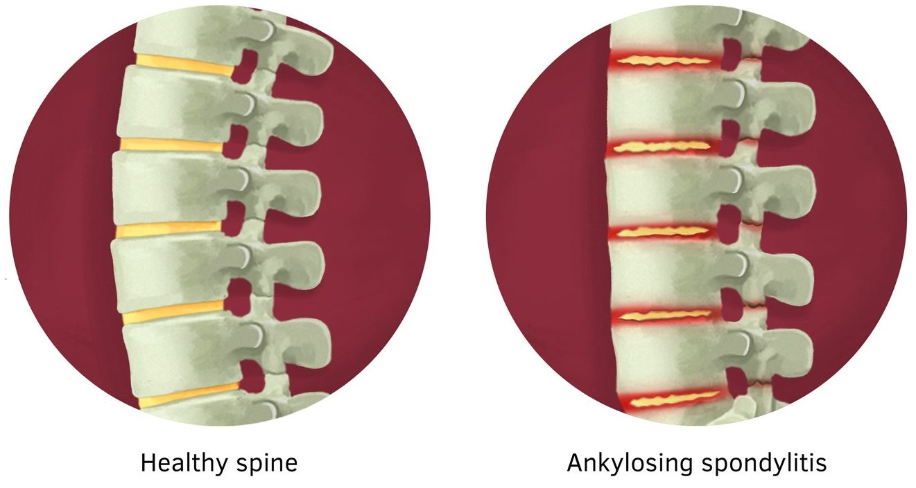
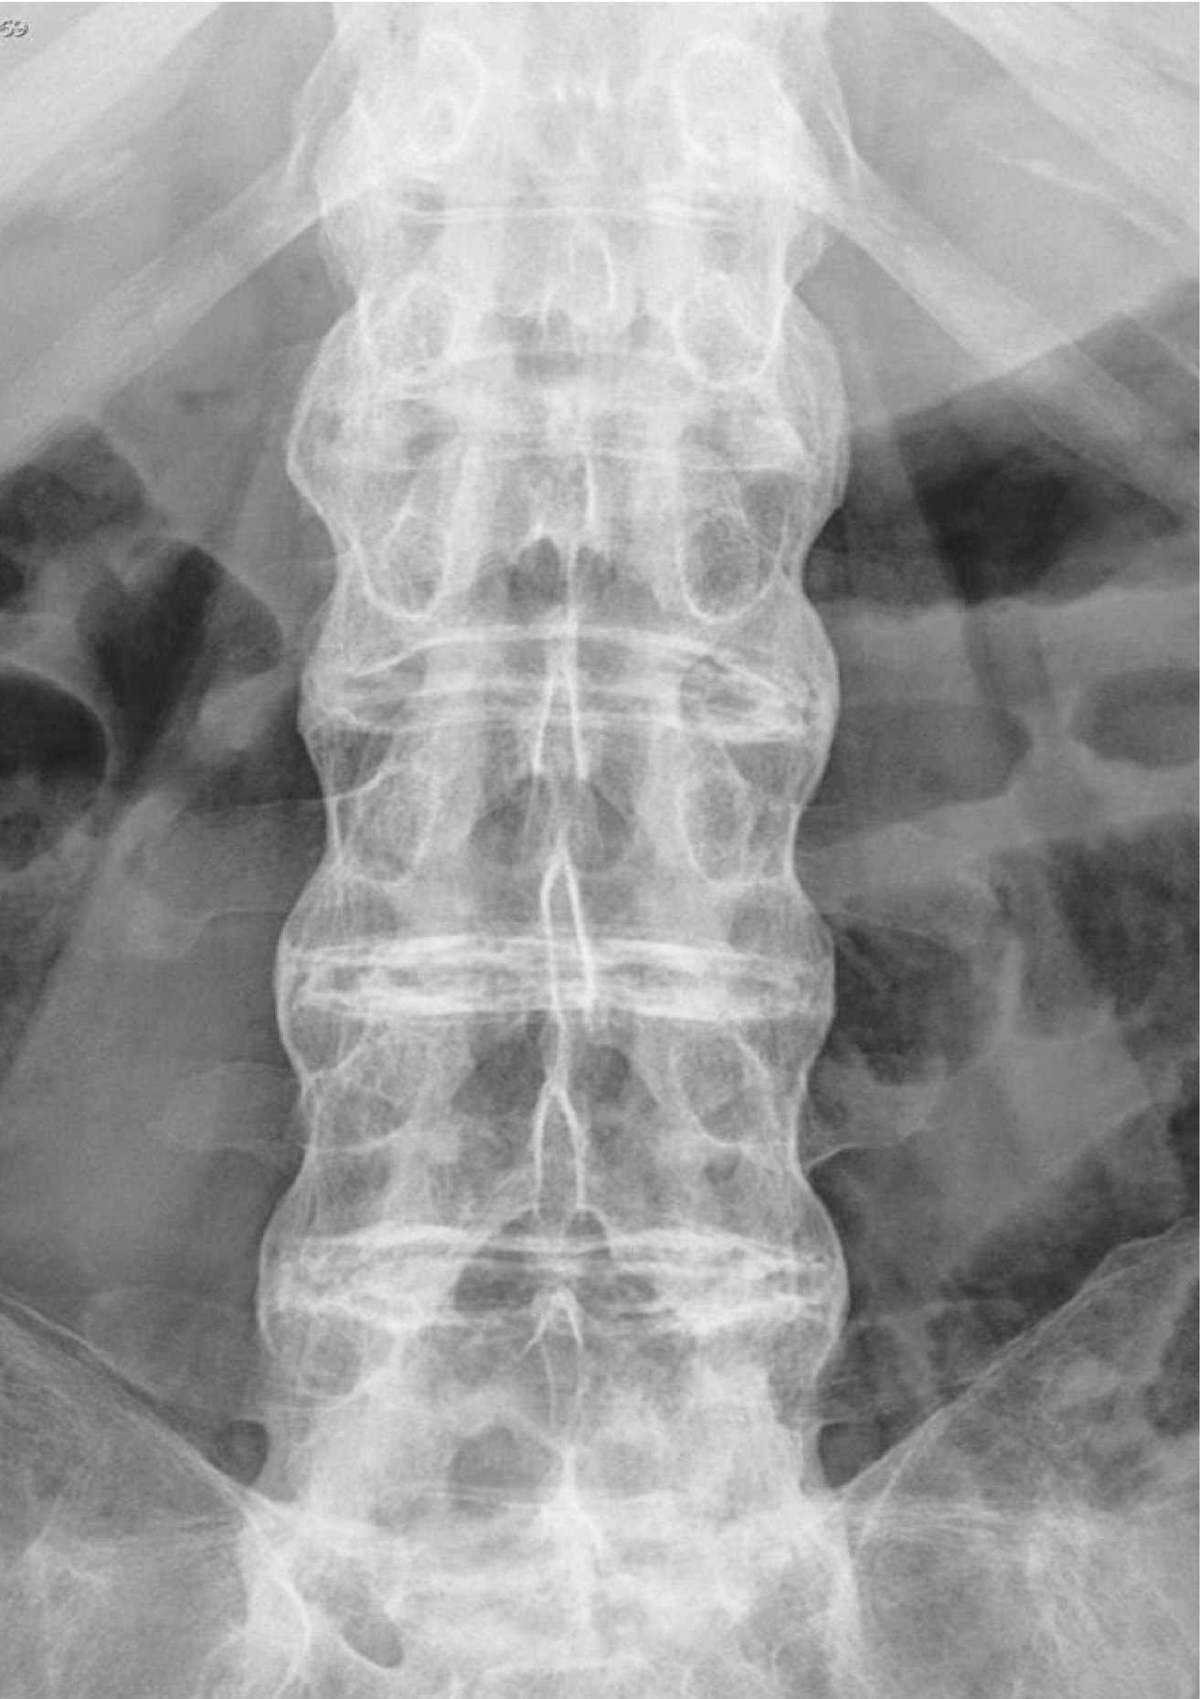
Evaluation of Allergy in Ankylosing Spondylitis
Ahmetcan Gültekin¹, Teoman Aydın²,
¹Bezmialem Vakif University, School of Medicine, Istanbul, Turkey
²Bezmialem Vakif University, School of Medicine, Department of Physical Therapy and Rehabilitation, Istanbul, Turkey
Introduction
While atopic disorders are associated with a predominant Th2 cytokine pattern, the cytokine pattern of ankylosing spondylitis (AS) can be described as an ‘impaired Th1 cytokine pattern’. It is known that the generation of a Th2 immune response is inhibited in the presence of Th1 cytokines. However, previous researches showed that patients with AS are more inclined to developing atopy. This study aims to find if there is an association between allergy and disease activity in patients with AS.
Materials and Methods
Patients with ankylosing spondylitis who are (HLAB27 positive) admitted to Bezmialem Vakıf University Medical Faculty Physical Therapy and Rehabilitation Polyclinic were included in our study. Patients are divided into two groups, based on their disease activity score which is determined by BASDAI(Bath Ankylosing Spondylitis Disease Activity Index). Serum immunoglobulin E (IgE) values and eosinophil count of these two groups were compared.
A total of 25 patients were included in this study; 11 male (%44), 14 female (%56), and average age were 42. 10 patients (%40) were scored BASDAI ≥4 (Group:1) and 15 (%60) BASDAI<4(Group2). The mean value of serum immunoglobulin e level of group 1 is 25,8(IU/ML) and group 2 is 22,6(IU/ML) (p=0,138). The mean value of eosinophil count of group 1 is 0,175(10*3/UL) and group 2 is 0,115(10*3/UL) (p=0,127). There was no significant difference between these two groups in terms of IgE and eosinophil count.
Results
 | Immunoglobulin E (IU/ml) | Eosinophil (10*3/ul)
Group 1 | 25,8 | 0,175
Group 2 | 22,6 | 0,115
Conclusion
Eosinophil count and serum IgE values of AS patients with high disease activity were not significantly different from AS patients with low disease activity. This result suggests that allergy is not a risk factor for disease activity of ankylosing spondylitis.
References
Wei-Pin C, Chun-Nan K, Li-Na K. Increase risk of allergic diseases in patients with ankylosing spondylitis. Medicine (Baltimore). 2016 Nov; 95(45)
2. Niu Q, Wei W, Huang Z, Zhang J, Yang B, Wang L. Association between food allergy and ankylosing spondylitis: An observational study. Medicine (Baltimore). 2019 Feb;98(6)
3. Rudwaleit M, Andermann B, Alten R, Sörensen H, Listing J, Zink A, Sieper J, Braun J. Atopic disorders in ankylosing spondylitis and rheumatoid arthritis. Ann Rheum Dis. 2002 Nov;61(11)
4. Turgan A, Ural A, Isık A, Arslan S. A preliminary report on the prevalence and clinical features of allergic rhinitis in ankylosing spondylitis patients. ENT Updates. 2015 May
5. Hunder GG, Gleich GJ. Immunoglobulin E (IgE) levels in serum and synovial fluid in rheumatoid arthritis. Arthritis Rheum. 1974 Nov-Dec;17(6):955-63.

